Slide 1


MONGO DATABASE
Rajeev Gupta
Rgupta.mtech@gmail.com
Java Trainer & Consultant

Slide 2
Mongodb NoSQL CONTENTS
Introduction to NoSQL
What is MongoDB?
What is NoSQL?
How is NoSQL(MongoDB) different
from conventional RDBMS?
Why MongoDB is important?
Key features of MongoDB
How to install & run MongoDB?
What we get in installation package?
What is JSON
JSON Example
Basic SQL to MongoDB Terminology Comparison
Major Datatypes in MongoDB
What is ObjectID (_id)?
Basic CRUD operations in MongoDB
Important Query methods in MongoDB
Important operators
RDBMS Where clause equivalents in
MongoDB
Where MongoDB is best suited?
Excellent MongoDB learning references

Slide 3

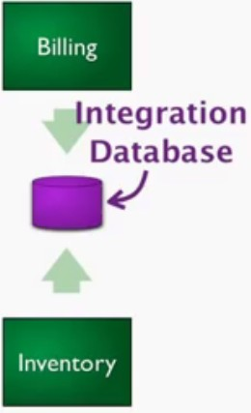
Background
Rise of RDBMS Why
Persistence, Integration, SQL, Tx Mgt, Reporting
Rise of OO Database
Don’t really picked…
RDBMS still dominant technologies
◉
Now What?
◉
◉

Slide 4
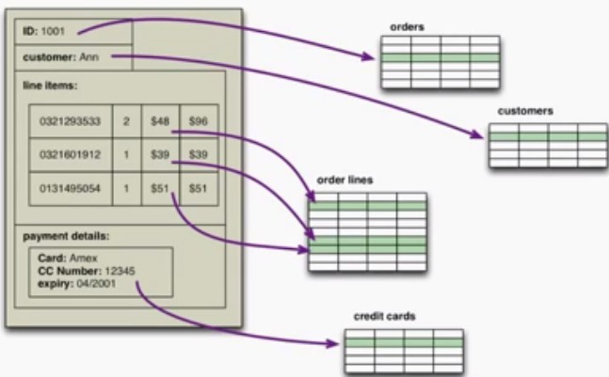
Problem with RDBMS?
We have to manually map Requirement to different tables..
It would be great if order can be stored as one Unit
Impedance
Mismatch=> ORM tools

Slide 5

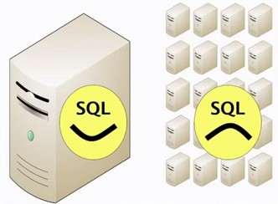

Why No SQL
Modern web application/ cloud create huge traffic Vertical Scale vs Horizontal scaling
Horizontal scaling/ Hadoop is the solution=> RDBMS can not scale
RDBMS is designed to run over big server rather then community H/W
Running Relational DBMS over cluster is not easy!
Industry comes with new solutions

Slide 6
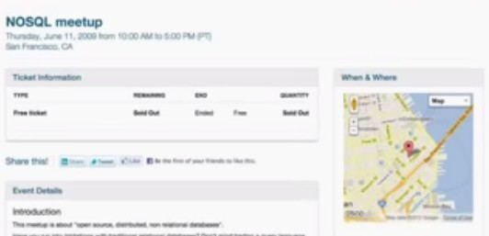
Why NoSQL named NoSQL?
John an big data guys propose meet up for alternative solution to RDBMS
Need twitter hashtag #nosql

Slide 7
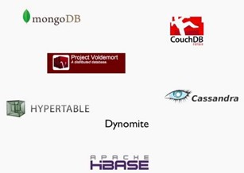
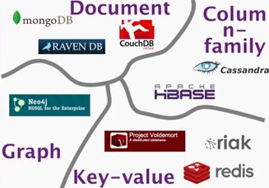
Categories of NoSQL
Document
MongoDB, Couch DB
Key value
Riak, Redis
Column family
Cassandra, Hbase
Graph
Neo4j

Slide 8
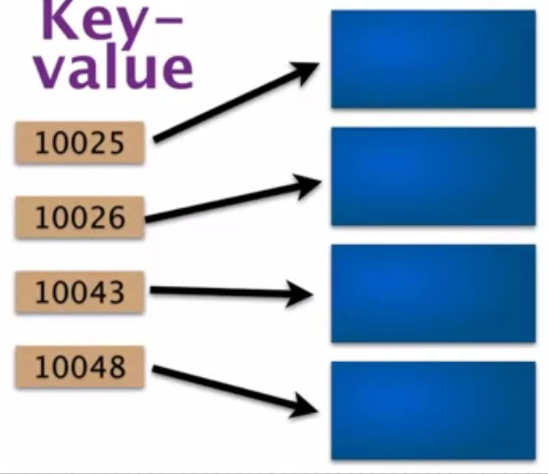
Characteristics of NoSQL
Non Relational model
Open Source
Cluster friendly
21st century web
Schema less design
Key-value store
Simplest model
Key have no idea what is actually stored against a key, it could be doc/image/Blob data
Aka hashMap Table==Bucket
Where should not be used?
Need relationship Need Tx
ACID
Quaries based on value eg: price>=200
◻
Use cases
◉
◉
◉
Storing session information User profile /Perference Shopping cart

Slide 9
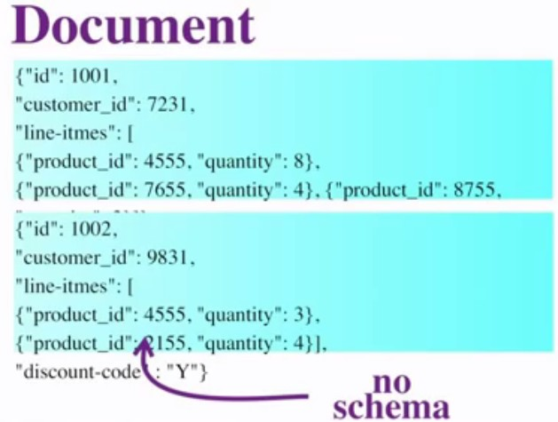
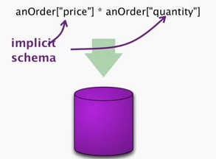
Document Data Model
Key -> Document (JSON) Flexible
Can quarries to doc
More transparent then key- value
Provide implicit schema

Slide 10
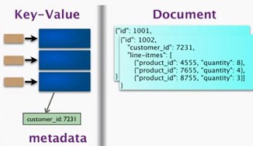
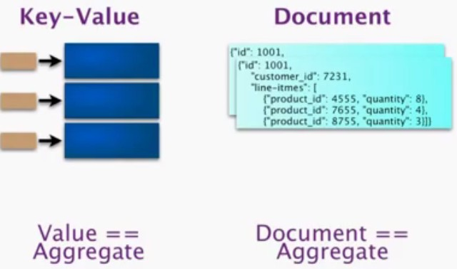
Key value vs. Document
◻
◻
Difference is very small Many key value database allowed use to have meta data like customer_id=7321 Index is allowed
◻
Collectively called Aggregate oriented
database

Slide 11
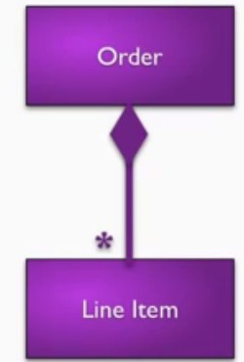
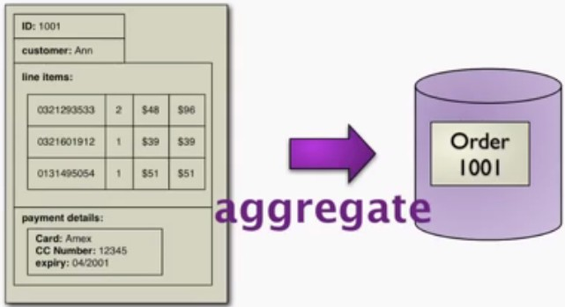
Aggregate database
Order is consider as a single unit that should be store in DB
Very useful in case of distributed cluster: Each aggregate can be stored in an node without join etc, Only one node need to refer to access one order details.

Slide 12
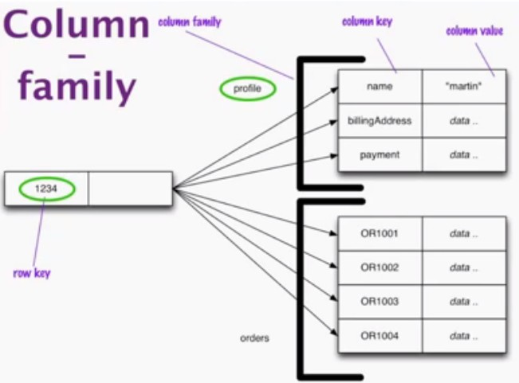
Column family DB
Aka Aggregate oriented DB
More Complicated then earlier model
Within one “Row key” we can store multiple column family, where each column family is combination of column that fit togather
Row Key+ column family name➔ aggregate
Easily retrieval of infidel elements

Slide 13
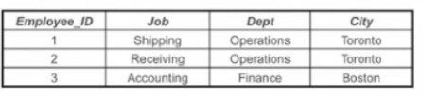
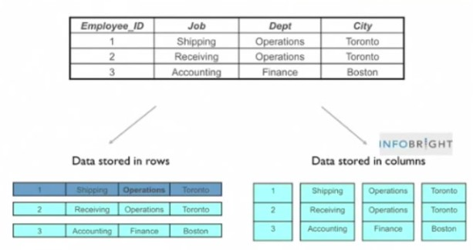
RDBMS vs Column db

Slide 14
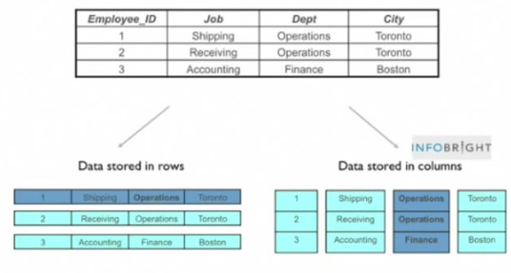
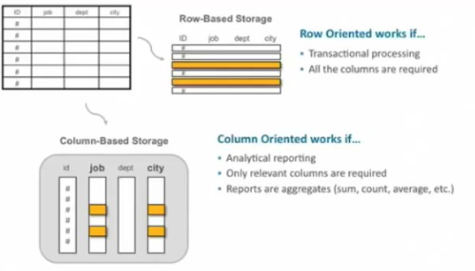

Slide 15
WHAT IS MONGODB?
MongoDB name comes from HuMONGOus data.
According to the official website of MongoDB it is defined in the following way –
MongoDB is a document database with the scalability and flexibility that you want with the querying and indexing that you need.
It is a NoSQL Database.
It is Open source and free to use.
It is a cross-platform database which works with almost every platform (Windows, mac, Linux) .
It stores data in flexible, JSON like documents.

Slide 16
WHAT IS NOSQL?
The mechanism of storing and retrieving the data without using the conventional way of storage i.e., inside table.
The storage mechanism adapted here is the non relational form of data.
NoSQL databases are also sometimes referred as “Not Only SQL”
Structured Query Language (SQL) adapts the conventional methods of having relations and some proper schema but NoSQL is completely different and it follows no schema.
NoSQL databases are divided in the following parts:
Document databases: used to store semi-structured data as documents (MongoDB, ArangoDB, RethinkDB, CouchDB). Data is represented as a JSON document.
Graph stores: used to store the information about the network of the data (Neo4J,
GraphBase,WhiteDB)
Key-value stores: Data is stored in the form of key-value pairs. They are the simplest NoSQL
Databases (Redis, DynamoDB, Riak, Berkeley DB).
Wide-column stores: It uses tables, rows and columns but the names and formats of the columns can vary from row to row in the same table (Cassandra and HBase).

Slide 17

HOW NOSQL IS DIFFERENT FROM CONVENTIONAL RDBMS?
SQL databases are table based databases whereas NoSQL databases are document based, key-value pairs, graph databases or wide-column stores.
SQL databases have predefined schema whereas NoSQL databases have dynamic schema for unstructured data.
SQL databases are vertically scalable whereas the NoSQL databases are horizontally scalable.
SQL databases are not best suited for hierarchal data storage whereas NoSQL is best suited for it.
 | RDBMS (SQL) | NoSQL
Base | Table (rows and columns) | Document, key-value pairs, graph and wide-column stores
Schema | Predefined | Dynamic
Scalability | Vertical | Horizontal
Category | Relational | Non-relational or Distributed
Big Data Preference | Preferred | Not preferred
Complex Query Preference | Preferred | Not preferred
Hierarchical Data Storage Preference | Not preferred | Preferred

Slide 18
WHY MONGODB IS IMPORTANT ?
MongoDB is important in many aspects and some of those major points are as follows:
It is document oriented and does not need the row and column format of the data.
It gives high performance.
It is dynamic in nature where you don’t need to predefine a schema like in conventional RDBMS.
There is no concept of Joins in MongoDB instead it has $lookup aggregation operator in versions >=3.2. There is a mongoose alternative as well which is called as populate() that is used to reference documents in other collections.
MongoDB stores data in JSON format which allows to send the data in whatever form you want.

Slide 19
KEY FEATURES OF MONGODB ?
Data is stored in BSON and presented in JSON.
Server-side JavaScript is supported (JavaScript expressions and functions).
Document oriented database where there are no tables and no row-based data.
NoSQL, where there is no schema. Documents can have different structures. Documents can be embedded. This is specifically designed for horizontal scaling.
By default, there is a primary key (_id), which is an auto-generated field for every document.
Sharding is supported which is very much essential for horizontal scaling and replication.
It has automatic load balancing configurations.
Fault Tolerance is natively built in MongoDB.

Slide 20
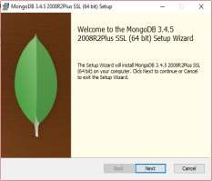
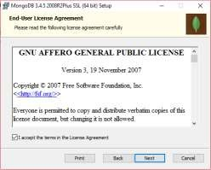
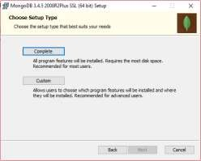
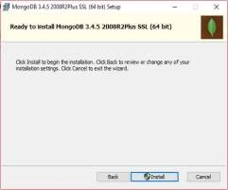
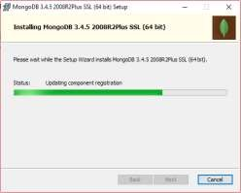
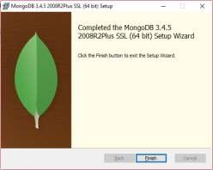
HOW TO INSTALL & RUN MONGODB ?

Slide 21
HOW TO INSTALL & RUN MONGODB ?
To install the MongoDB you need to visit the download section of the official website. Visit the following link:https://www.mongodb.com/download-
center/community.
Select the version, OS and the package there and then click download.
After download is completed double click the file (e.g.:- mongodb-win32-x86_64- 2008plus-ssl-3.4.5-signed.msi). This will start the installation.
Go through all the steps. Simply click next on each step and at the last step click on
Finish button. This will install the MongoDB on your system.
RUNNING THE MONGODB IN SYSTEM:
Create the folder → C:\data\db (In this case after creating the folder, you need to double click the mongod.exe file or just need to start the command line terminal and run the command mongod).

Slide 22








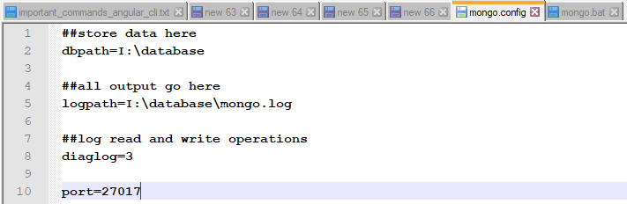
HOW TO INSTALL & RUN MONGODB ?
…in continuation
Alternatively you can create the folder at a different location and give its reference in mongo.config file. Then in mongo.bat file write the reference of the mongo.config file and run it whenever you want to start the mongodb server.
Mongo.config file has some other parameters which are described in the below image.
It comprises database path reference, log file path reference and port number reference.

Slide 23
HOW TO INSTALL & RUN MONGODB ?
…in continuation
The mongo.bat file will have a reference to mongo.config file.
The command written inside the mongo.bat file is:
It is shown in the below image.
This will allow the server to read the config file and refer the location of the database.
The default port that the mongodb server reads is 27017.

Slide 24
WHAT IS THERE IN INSTALLATION PACKAGE ?
MongoDB comes with handy tools which are bundled together at a single place.
Those tools are as follows:
mongod : Mongo demon which is the server.
mongo : It is a CLI based client.
mongos : It is a mongodb sharing routing service(Used for sharding).
mongostat : It is used for monitoring the Quick Overview of the running instance.
mongotop : It is used for monitoring the Read and Write of an instance.
NOTE:
To start the server we just need the mongod file.
For the ease of learning and exploring MongoDB, you can install any MongoDB GUI tool at this point (Robo 3T, QueryAssist, NoSQLBooster, Studio 3T, MongoDB Compass, Mongo Management Studio, NoSQL Manager, NoSQL Client, Navicat for MongoDB)

Slide 25
WHAT IS THERE IN INSTALLATION PACKAGE ?
…in continuation
mongorestore: It loads data from the Binary DB dump.
bsondump & mongodump: It creates binary dump.
mongooplog: It is used for the purpose of the replication from the oplog.
mongoexport & mongoimport: It is used to export or import files(generally JSON & CSV).
mongoperf: It is used to check the Disk IO.
mongofiles: It is basically used for GridFS functionality.

Slide 26
WHAT IS JSON?
Before proceeding any further you must know what is JSON as MongoDB data is always represented in the JSON format. So, here are some of the essential points related to JSON.
JSON stands for JavaScript Object Notation. It is a collection of key-value pairs. Keys must be written inside single or double quotes. Values can have any data type (Array, string, Boolean etc.)
JSON file must start and end with a curly brace.
Collection of key-value pair → Various languages recognize it as an object,
record, struct, dictionary, hash table, keyed list, or associative array.
Object is surrounded by the curly braces and key-value pairs are separated by comma.
Array is surrounded by square braces and each value is separated with a comma.
Value can be of any type → string, number, object, array, true, false, null

Slide 27
JSON EXAMPLE
{
“firstName”: “John”,
“lastName”: “Doe”, “age”: 25,
“address”: {
“streetAddress”: “221B Bakers Street”, “city”: “London”,
“state”: “ENG”, “postalCode”: “200001”
},
}
Notice here the key-value pair form of data that is embedded inside the curly braces.

Slide 28
BASIC SQL TO MONGODB TERMINOLOGY COMPARISON
Terminology & Concept Comparison:
SQL | MongoDB
database | database
table | collection
row | document or BSON document
column | field
index | index
table joins | $lookup, embedded documents
primary key (need to specify column or combination of column) | primary key (automatically set to _id field)
aggregation | aggregation pipeline
Database Executables Comparison:
 | MongoDB | MySQL | Oracle | Informix | DB2
Database Server | mongod | mysqld | oracle | IDS | DB2 Server
Database Client | mongo | mysql | sqlplus | DB-Access | DB2 Client

Slide 29
MAJOR DATATYPES IN MONGODB ?
String
Integer
Boolean
Double
Min/Max keys
Arrays
Timestamp
Object
Null
Symbol
Date
ObjectID
Binary data
Code
Regular expression

Slide 30
WHAT IS objectId (_id) ?
ObjectId in the MongoDB is same as the primary key in the conventional RDBMS.
It is by default set by MongoDB for every document that is created inside any collection.
ObjectIds are small, unique, fast to generate and ordered.
ObjectId values comprises of a 12 bytes hexadecimal number which is unique
for every document.
_id: ObjectId(4 bytes timestamp, 3 bytes machine id, 2 bytes process id,
3 bytes counter)
"_id": ObjectId("5901832c91427cac52e9ea8f")

Slide 31
BASIC CRUD OPERATIONS
The basic operations in every database comprises of the following four operations:
CRUD
In MongoDB these four basic operations are achieved using the unique style of writing. But before actually starting with the data, you must first create a database.
In MongoDB, database is created using the use command.

Slide 32
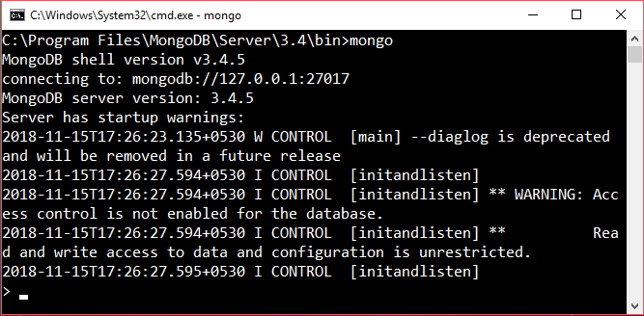
BASIC CRUD OPERATIONS
STARTING THE MONGODB INSTANCE IN THE TERMINAL
1. Go to the terminal and give the command mongo there so as to start the MongoDB CLI.
This will start the mongo instance in the terminal from where you can work on mongodb and fire queries.

Slide 33
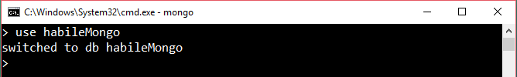
BASIC CRUD OPERATIONS
…in continuation
CREATING THE DATABASE USING THE use COMMAND
Go to the terminal and write the command use <database_name> where database name will be replaced by the name of your database. This will create the database with the name which you want.
Alternatively it can be achieved by using any of the GUI tool and from there you can create the new database. But this GUI tool will first need to be connected to the host at the desired port number.

Slide 34
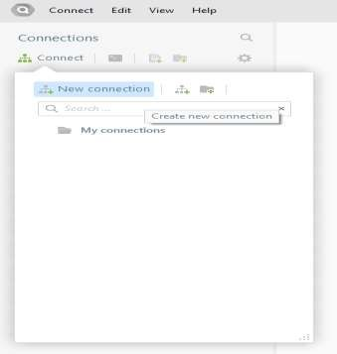
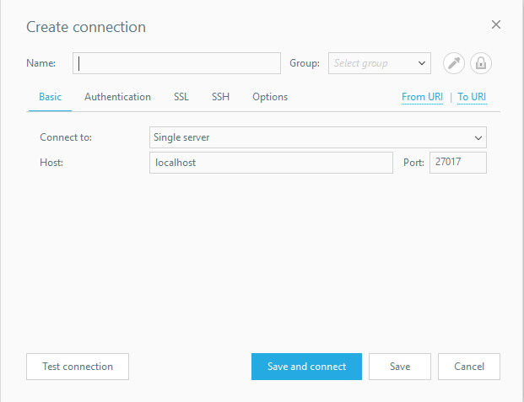
BASIC CRUD OPERATIONS
The GUI tool which is shown above is QueryAssist You can Give a name to the instance from the tool.

Slide 35
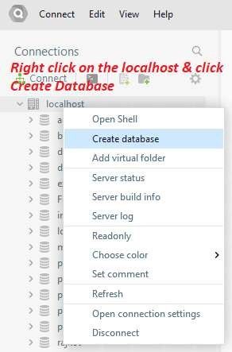
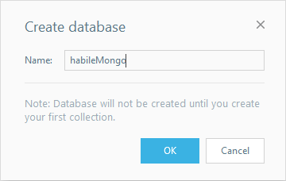
BASIC CRUD OPERATIONS
By this way you can create the database in MongoDB.
Observe the note written in the Create Database Pop Up

Slide 36
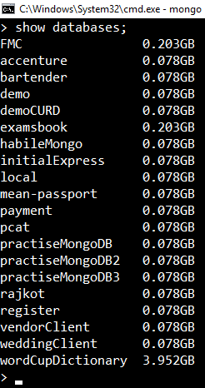
BASIC CRUD OPERATIONS
NOTE: You can ensure that your database has been created or not by using the show databases or show dbs command. The database will only appear when you have at least one collection inside it.
To create a collection inside the recently created database, you must use the insert command:
db.employee.insert({'name': 'John Doe', 'empId': 'HL0014’});
Now when you hit the show dbs or show databases command, it will show your database.

Slide 37
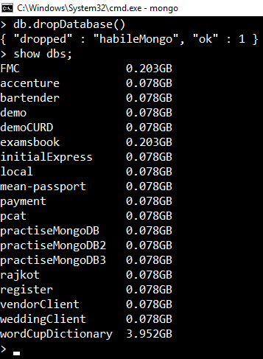
BASIC CRUD OPERATIONS
DROPPING A DATABASE
To drop a database in MongoDB you need to type the following command.
db.dropDatabase()
This will drop the selected database. If database is not selected then it will delete the default ‘test’ database.
Now you can check through show dbs or show databases command, that your created database is dropped.
You can clearly see in the picture that the habileMongo database is now not listed. It was dropped using the command above.

Slide 38
BASIC CRUD OPERATIONS
For previous operation’s result to be visible, one must first create a
collection inside it. So, let’s start with CRUD operations.
CREATE
For creating a collection use the following command
db.createCollection(name, options)
Parameter | Type | Description
Name | String | It is the name of the collection that is to be created
Options | Document | Specifies option about the memory size and indexing. This is completely optional.

Slide 39
BASIC CRUD OPERATIONS
Options can have the following fields:
Field | Type | Description
capped | Boolean | (Optional) If true, enables a capped collection. Capped collection is a fixed size collection that automatically overwrites its oldest entries when it reaches its maximum size. If you specify true, you need to specify size parameter also.
autoIndexId | Boolean | (Optional) If true, automatically create index on _id fields. Default value is false.
size | number | (Optional) Specifies a maximum size in bytes for a capped collection. If capped is true, then you need to specify this field also.
max | number | (Optional) Specifies the maximum number of documents allowed in the capped collection.

Slide 40
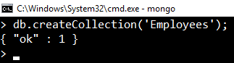
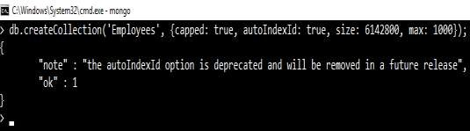
BASIC CRUD OPERATIONS
EXAMPLE:
1. Without Options parameter –
db.createCollection(‘Employees’);
This will create the Employees collection.
2. With Options parameter
db.createCollection(‘Employees’, {capped: true, autoIndexId: true, size: 6142800, max: 10000});

Slide 41
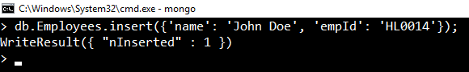
BASIC CRUD OPERATIONS
INSERT DOCUMENT
For inserting the document in MongoDB collection, you need to write the following command:
db.collection_name.insert(document)
Where in place of collection name you can place your collection name.
db.Employees.insert({‘name’: ‘John Doe’, ‘empId’: ‘HL0014’})

Slide 42
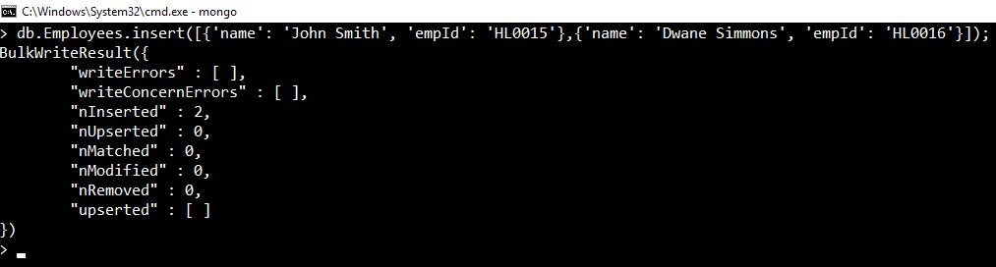
BASIC CRUD OPERATIONS INSERT DOCUMENT
To insert multiple documents inside a single query, you must pass an
array of documents in the insert() command:
db.Employees.insert([{'name': 'John Smith', 'empId': 'HL0015'},{'name': 'Dwane Simmons', 'empId': 'HL0016'}]);
…to be continued

Slide 43
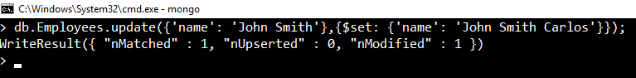
BASIC CRUD OPERATIONS
UPDATE
For updating any document, an update() or save() method is used:
db.Employees.update({'name': 'John Smith’},{$set:{'name': 'John Smith Carlos’}});
NOTE: By default mongodb will update only a single document. To update multiple documents , there is a need to set the ‘multi’ parameter to true.
db.Employees.update({'name': 'John Smith’},{$set:{'name': 'John Smith
Carlos’}}, {multi: true});

Slide 44
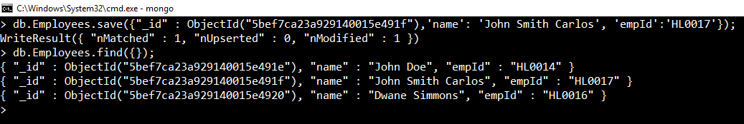




















BASIC CRUD OPERATIONS
UPDATE
Using save() method:
Save method will replace the existing document with the new document passed in the save() method.
db.Employees.save({"_id" : ObjectId("5bef7ca23a929140015e491f"),'name': 'John Smith Carlos', 'empId':'HL0017’});
NOTE: If Save method is used without _id, then it will update the document else it will insert a document.

Slide 45
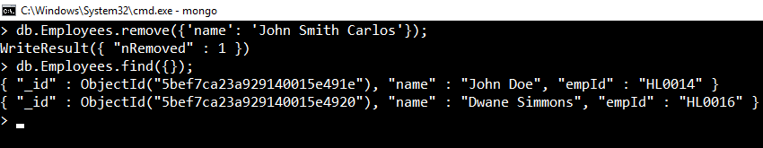
BASIC CRUD OPERATIONS DELETE
To delete a document , MongoDB has remove() method.
db.Employees.remove({'name': 'John Smith Carlos’});
This will remove all the documents matching with the conditions.
To remove only one matching document there is deleteOne() method or
remove() method with justOne parameter.

Slide 46
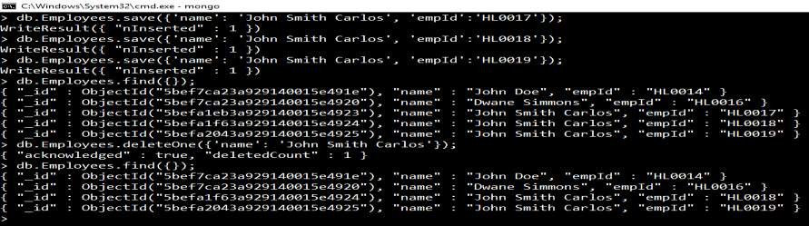
BASIC CRUD OPERATIONS
DELETE
To delete a document , MongoDB has remove() method.
db.Employees.deleteOne({'name': 'John Smith Carlos’});
The other way to delete single document is : use the findOne() method first to find the matching first document and then use remove() method.

Slide 47
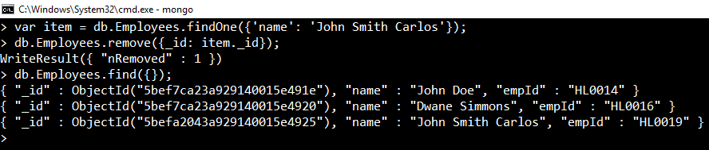
BASIC CRUD OPERATIONS DELETE
This way you can remove a particular document from the collection.
findOne() method searches all the data and returns the first matching
document. You can pass the condition inside the findOne() method.m
NOTE: If you don’t specify the deletion criteria (db.Employees.remove()), then it will delete all the documents inside the collection.

Slide 48
IMPORTANT PROJECTION & QUERY METHODS find()
find() is the essential projection method which helps in selecting only the necessary data.
db.Employees.find({});
findOne()
This method returns the first matched document from the collection. You need to specify the condition inside the findOne() method.
db.Employees.findOne({'name': 'John Smith Carlos’});
pretty()
This method is used to display the text in the formatted way.

Slide 49
IMPORTANT PROJECTION & QUERY METHODS
distinct()
distinct() is the essential method which helps in returning an array of documents that have distinct values for a specified field.
db.Employees.distinct({‘name’});
isCapped()
This method is used to check whether that collection is capped or not.
db.Employees.isCapped();
It will return a Boolean value. If capped then true other wise false.
limit()
This method is used to limit the records in MongoDB. It accepts the number type
argument.
db.Employees.find({}).limit(2);

Slide 50
IMPORTANT PROJECTION & QUERY METHODS
skip()
This method is used to skip the number of documents. It accepts the number type argument.
db.Employees.find({}).limit(1).skip(1);
sort()
This method is used to sort the documents in MongoDB.
db.Employees.find({}).sort({‘name’: -1});
This will sort the document in descending order on the field name.

Slide 51
IMPORTANT OPERATORS
AND
This is the operator used to query the data with AND relation. It will search the document satisfying the conditions that you pass in the query.
db.Employees.find({$and: [{‘name’: ‘John Smith Carlos’},
{‘EmpId’: ‘HL0020’}]});
OR
This operator is used to query the data with OR relation. It will search the document and return the result if any of the specified condition is fulfilled.
db.Employees.find({$or: [{‘name’: ‘John Smith Carlos’}, {‘EmpId’: ‘HL0020’}]});

Slide 52
RDBMS WHERE CLAUSE EQUIVALENTS IN MONGODB
Operation | Syntax | Example | RDBMS Equivalent
Equality | {<key>:<value>} | db.Employees.find({"name":"John Doe"}).pretty() | where name = John Doe'
Less Than | {<key>:{$lt:<value>}} | db.Employees.find({"salary":{$lt:20000}}). pretty() | where salary < 20000
Less Than Equals | {<key>:{$lte:<value>}} | db.Employees.find({"salary":{$lte:20000}} ).pretty() | where salary <= 20000
Greater Than | {<key>:{$gt:<value>}} | db.Employees.find({"salary":{$gt:20000}}) .pretty() | where salary > 20000
Greater Than Equals | {<key>:{$gte:<value>}} | db.Employees.find({"salary":{$gte:20000}} ).pretty() | where likes >= 20000
Not Equals | {<key>:{$ne:<value>}} | db.Employees.find({"salary":{$ne:20000}}) .pretty() | where likes != 20000

Slide 53
WHERE MONGODB IS BEST SUITABLE?
MongoDB is best suited for unstructured and semi-structured data such as:
Social media posts
Web pages
Emails
Medical records
Reports
Raw data from marketing researches
Scientific data

Slide 54
EXCELLENT MONGODB LEARNING REFERENCES
SQL to MongoDB mapping Chart https://docs.mongodb.com/manual/reference/sql-comparison/
What is NoSQL? https://www.mongodb.com/nosql-explained
MongoDB and MySQL Comparison https://www.mongodb.com/compare/mongodb-mysql
MongoDB Cheat Sheet https://blog.codecentric.de/files/2012/12/MongoDB-CheatSheet- v1_0.pdf
Organized Reference card – PDF file – Dzone
https://dzone.com/refcardz/mongodb?chapter=1
…to be continued

Slide 55
EXCELLENT MONGODB LEARNING REFERENCES
Online Course Catalogue https://university.mongodb.com/courses/catalog
MongoDB resources – starter kit
https://resources.mongodb.com/getting-started-with-mongodb
Brief Introduction to MongoDB by Eliot Horowitz (CTO & Co- founder of MongoDB) https://www.youtube.com/watch?v=EE8ZTQxa0AM

Slide 56

THANK YOU

